Slide 1
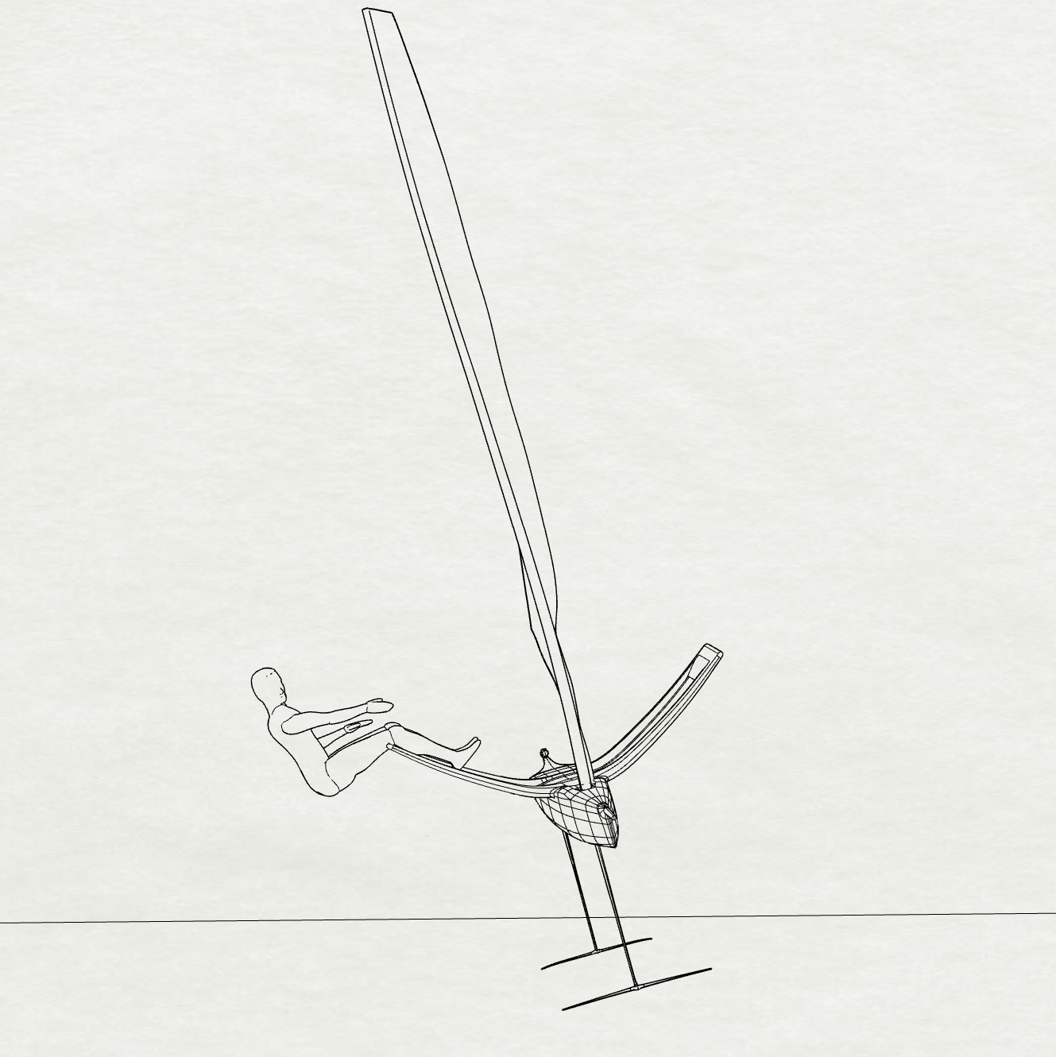
Heel º
Sail Lift
Sideforce
Rig Weight
Hull Weight
Crew Weight
Rudder Lift
Strut
Sideforces
Mainfoil Lift

Slide 2
Heel º
Sail Lift
Sideforce
Rig Weight
Crew
Weight
Platform
Weight
Rudder Lift
Strut
Sideforces
Mainfoil Lift

Slide 3
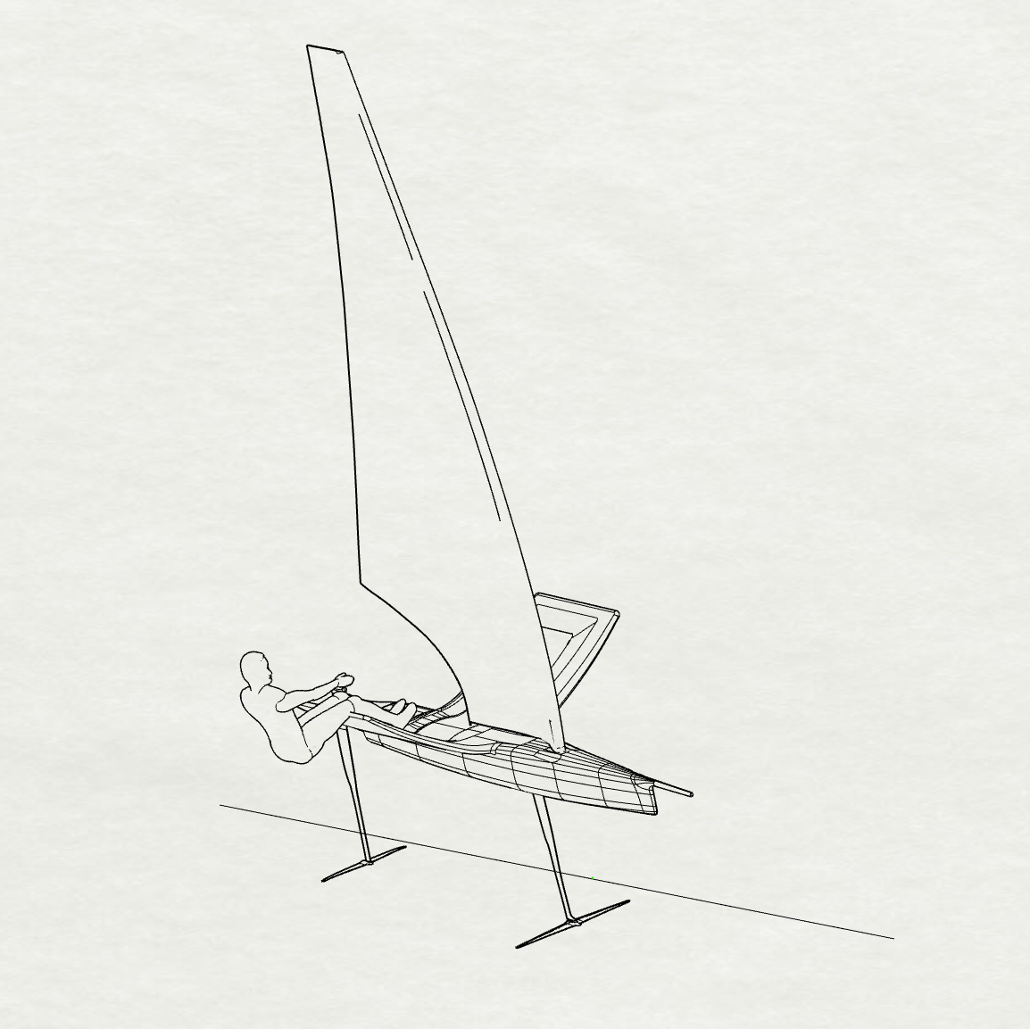
Heave
+z
Yaw
+y
Sway
Pitch
+x
Surge
Heel

Slide 4
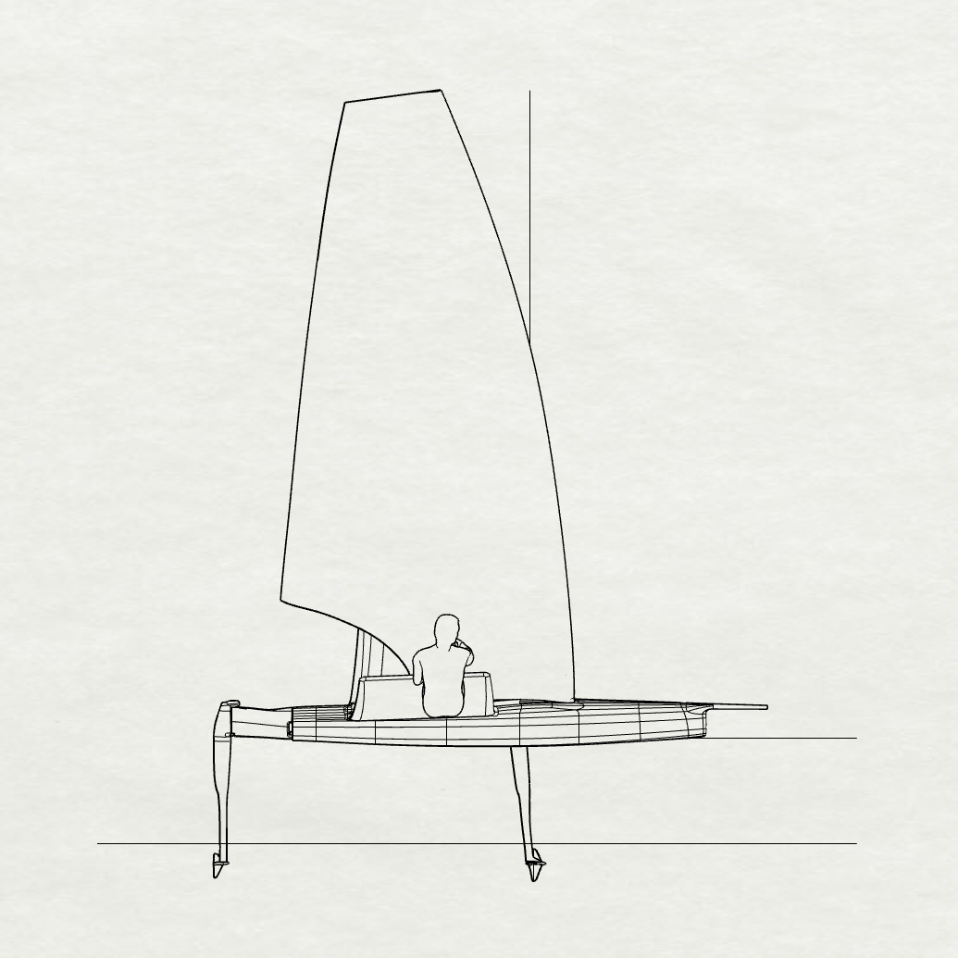
+ y
Sail Lift ^{*if heeled}
Drag_{A}
Rig
Weight
Drag_{A}
V_{s}
Drag_{A}
Crew
Weight
Platform
Weight
+ x
Rudder Lift
Drag_{H}
Drag_{H}
Mainfoil Lift

